Slide 1

Chapter 4
Digital
Transmission
Copyright © The McGraw-Hill Companies, Inc. Permission required for reproduction or display.
Notes:
1

Slide 2
Chapter 4: Outline
4.1 DIGITAL-TO-DIGITAL CONVERSION
4.2 ANALOG-TO-DIGITAL CONVERSION
4.1 TRANSMISSION MODES

Slide 3

Chapter4: Objective
The first section discusses digital-to-digital conversion. Line coding is used to convert digital data to a digital signal. Several common schemes are discussed. The section also describes block coding, which is used to create redundancy in the digital data before they are encoded as a digital signal. Redundancy is used as an inherent error detecting tool. The last topic in this section discusses scrambling, a technique used for digital-to-digital conversion in long-distance transmission.
The second section discusses analog-to-digital conversion. Pulse code modulation is described as the main method used to sample an analog signal. Delta modulation is used to improve the efficiency of the pulse code modulation.

Slide 4
Chapter4: Objective (continued)
The third section discusses transmission modes. When we want to transmit data digitally, we need to think about parallel or serial transmission. In parallel transmission, we send multiple bits at a time; in serial transmission, we send one bit at a time.

Slide 5
4-1 DIGITAL-TO-DIGITAL CONVERSION
In Chapter 3, we discussed data and signals. We said that data can be either digital or analog. We also said that signals that represent data can also be digital or analog. In this section, we see how we can represent digital data by using digital signals. The conversion involves three techniques: line coding, block coding, and scrambling. Line coding is always needed; block coding and scrambling may or may not be needed.

Slide 6
4.4.1 Line Coding
Line coding is the process of converting digital data to digital signals. We assume that data, in the form of text, numbers, graphical images, audio, or video, are stored in computer memory as sequences of bits (see Chapter 1). Line coding converts a sequence of bits to a digital signal. At the sender, digital data are encoded into a digital signal; at the receiver, the digital data are recreated by decoding the digital signal. Figure 4.1 shows the process.
Notes:
4.#

Slide 7
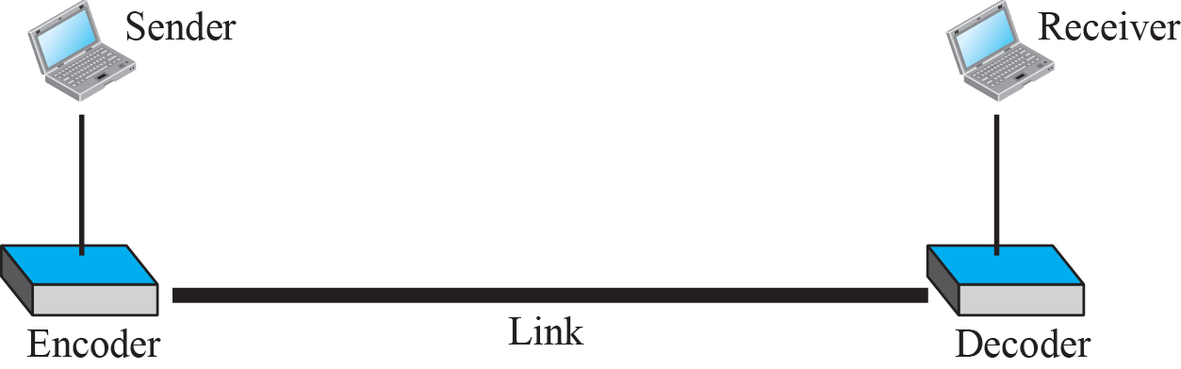
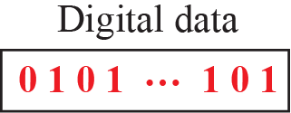
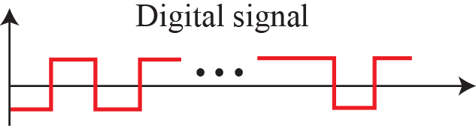
Figure 4.1: Line coding and decoding
Notes:
4.#

Slide 8
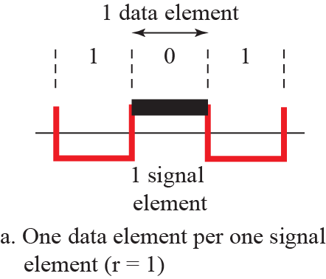
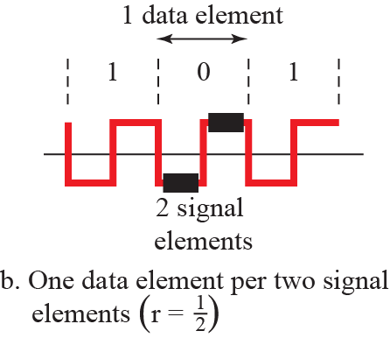
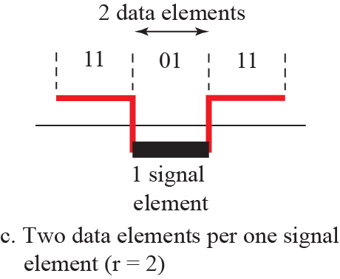
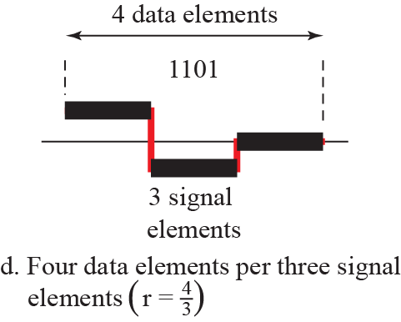
Figure 4.2: Signal elements versus data elements
Notes:
4.#

Slide 9
Example 4.1
A signal is carrying data in which one data element is encoded as one signal element (r = 1). If the bit rate is 100 kbps, what is the average value of the baud rate if c is between 0 and 1?
Baud rate(S)=C * N * (1/R)
N=bit rate
R=no of data element in one signal
S=Signal element per second
Baud rate <= bit rate
Baud rate=Number of signal units or symbols transmitted per second
Baud Rate=Bit Rate/Number of Bits per Symbol
Solution
We assume that the average value of c is 1/2. The baud rate is then
4.9
Notes:
9

Slide 10
Example 4.2
The maximum data rate of a channel (see Chapter 3) is N_{max} = 2 × B × log2 L (defined by the Nyquist formula). Does this agree with the previous formula for N_{max}?
Solution
A signal with L levels actually can carry log2 L bits per level. If each level corresponds to one signal element and we assume the average case (c = 1/2), then we have
N_{max} = (1/c) * B * r =2 * B * log₂L
4.10
Notes:
10

Slide 11
Example 4.3
In a digital transmission, the receiver clock is 0.1 percent faster than the sender clock. How many extra bits per second does the receiver receive if the data rate is 1 kbps? How many if the data rate is 1 Mbps?
Solution
At 1 kbps, the receiver receives 1001 bps instead of 1000 bps.
At 1 Mbps, the receiver receives 1,001,000 bps instead of 1,000,000 bps.
4.11
Notes:
11

Slide 12
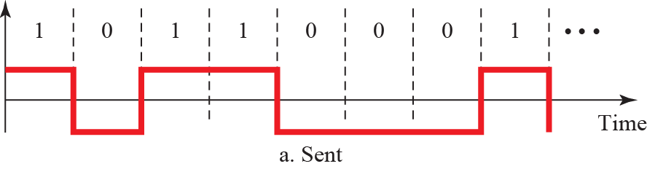
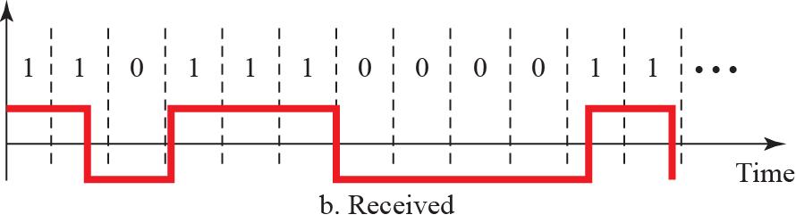
Figure 4.3: Effect of lack of synchronization
Notes:
4.#

Slide 13
4.4.2 Line Coding Schemes
We can roughly divide line coding schemes into five broad categories, as shown in Figure 4.4.
There are several schemes in each category. We need to be familiar with all schemes discussed in this section to understand the rest of the book. This section can be used as a reference for schemes encountered later.
Notes:
4.#

Slide 14
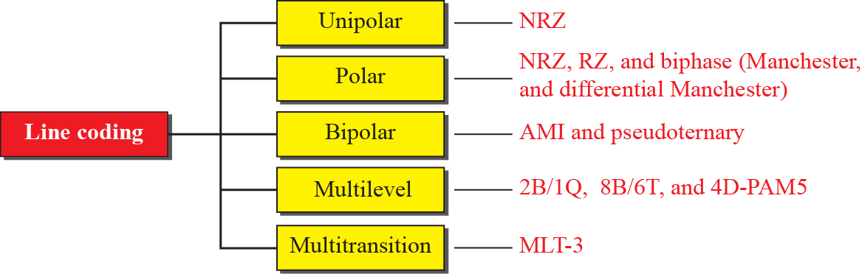
Figure 4.4: Line coding scheme
Notes:
4.#

Slide 15
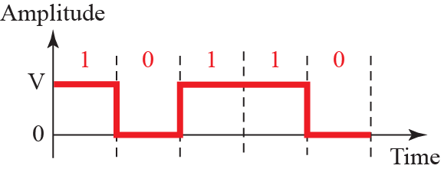
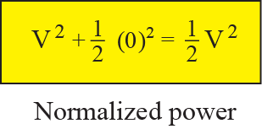
Figure 4.5: Unipolar NRZ scheme
NRZ Scheme me jab same bit aae to previous signal continue
karna h but jab diff bit aae to signal change karna h yha signal
+ve side hi rehta h
Notes:
4.#

Slide 16
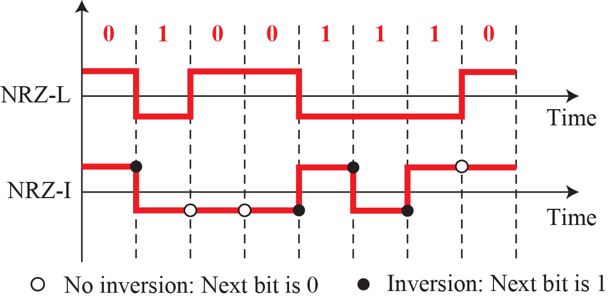
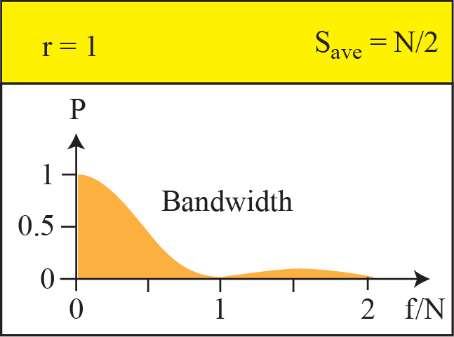
Figure 4.6: Polar schemes (NRZ-L and NRZ-I)
NRZ-L:- me jab bit same hoti h to previous signal continue
karte h yha base line signal ke mid me hoti h yha
signal –ve side bhi ja sakta h
NRZ-I:-me jab bit 1 hoti h to signal change karna hota h
agar bit 0 h to previous signal ko continue karte h
yha bhi signal –ve side ja sakta h
NRZ-I:-me ham ye islyea karte h because hame baseline wondering
min karna h
Notes:
4.#

Slide 17
Example 4.4
A system is using NRZ-I to transfer 10-Mbps data. What are the average signal rate and minimum bandwidth?
Solution
The average signal rate is S = N/2 = 500 kbaud. The minimum bandwidth for this average baud rate is B_{min} = S = 500 kHz.
4.17
Notes:
17

Slide 18
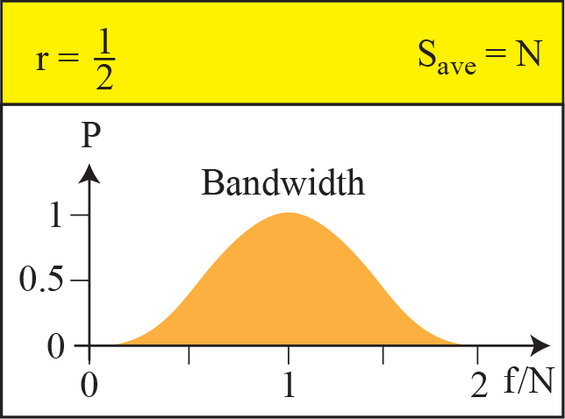
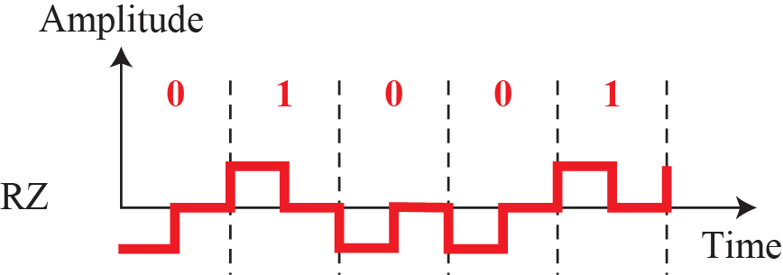
Figure 4.7: Polar schemes (RZ)
0
+ve
0->
1->
-ve
0
Notes:
4.#

Slide 19
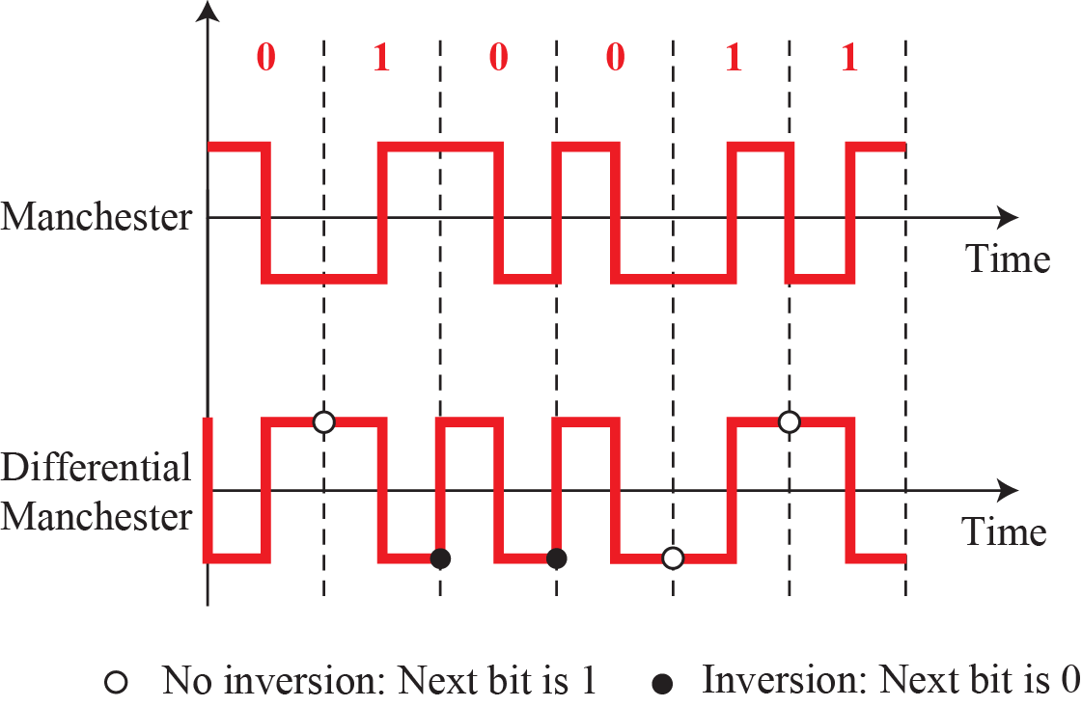
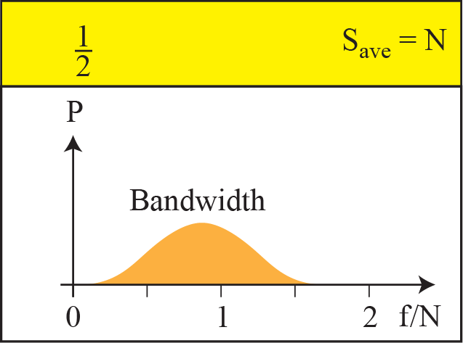
Figure 4.8: Polar biphase
Manchester
+ve
+ve
0->
0->
1->
-ve
-ve
1->
Notes:
4.#

Slide 20
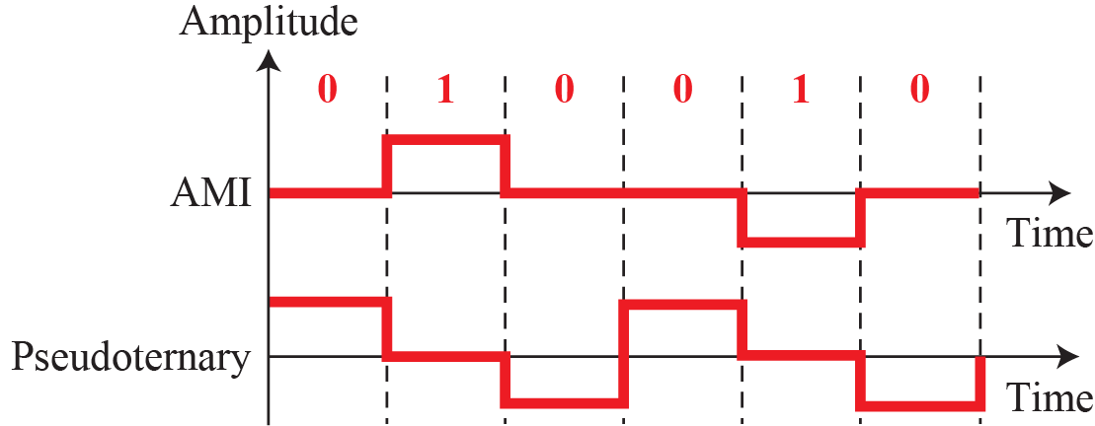
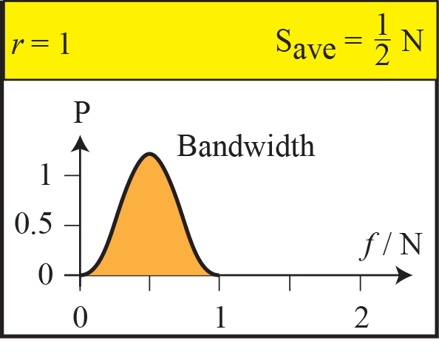
Figure 4.9: Bipolar schemes: AMI and pseudoternary
AMI:- 0 bit on base line and when 1 come on upper side than when next
time 1 bit come it go to lower side
Pseudoternary:-1 bit on base line and when 0 firstly come on upper side
than when next time 0 bit is come it go to lower side
Notes:
4.#

Slide 21
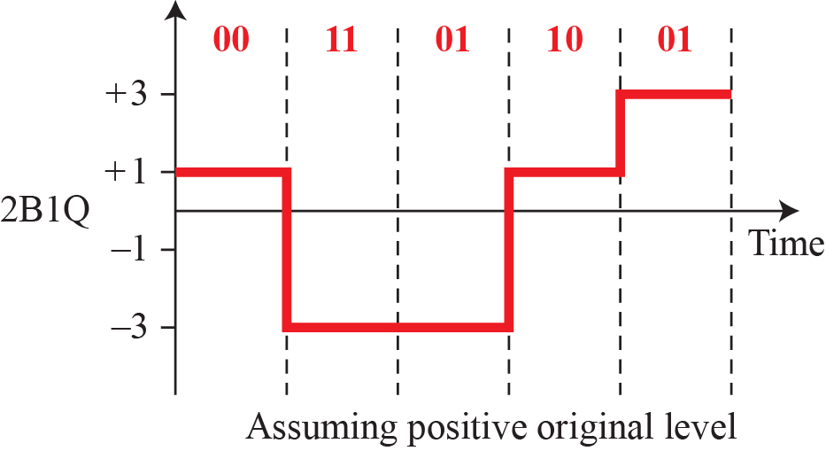
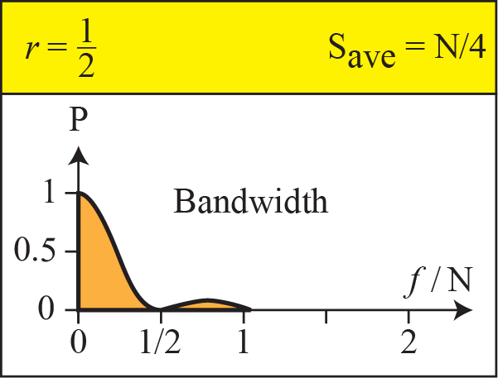
Figure 4.10: Multilevel: 2B1Q
Notes:
4.#

Slide 22
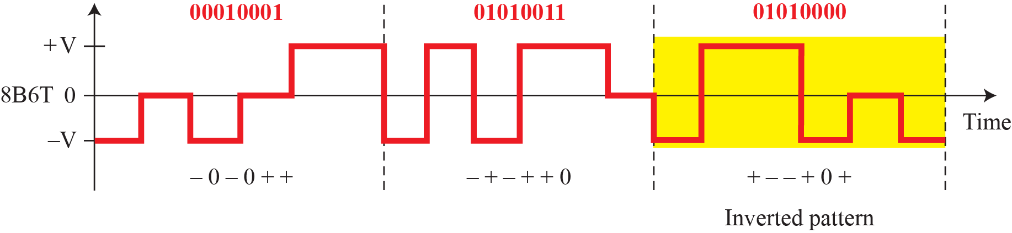
Figure 4.11: Multilevel: 8B6T
Notes:
4.#

Slide 23
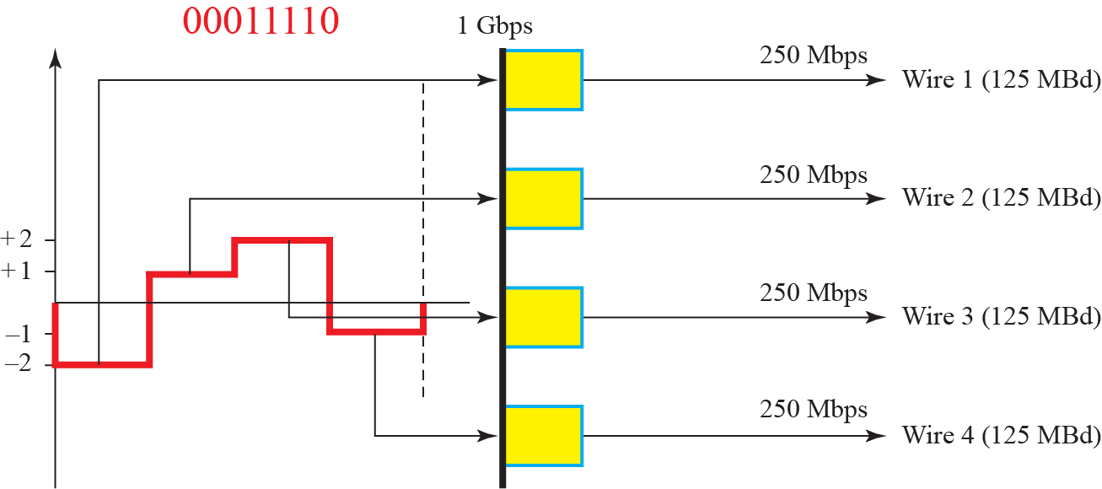
Figure 4.12: Multilevel: 4D-PAMS scheme
Notes:
4.#

Slide 24
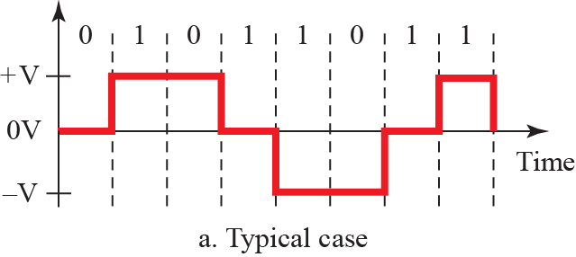
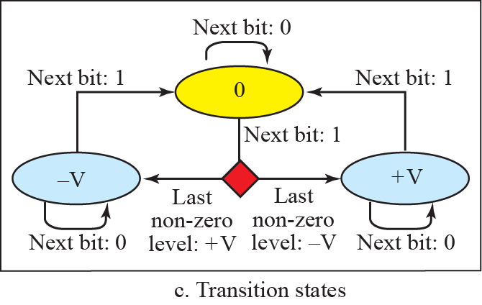
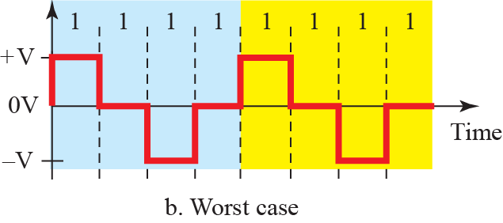
Figure 4.13: Multi-transition MLT-3 scheme
Notes:
4.#

Slide 25
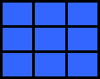
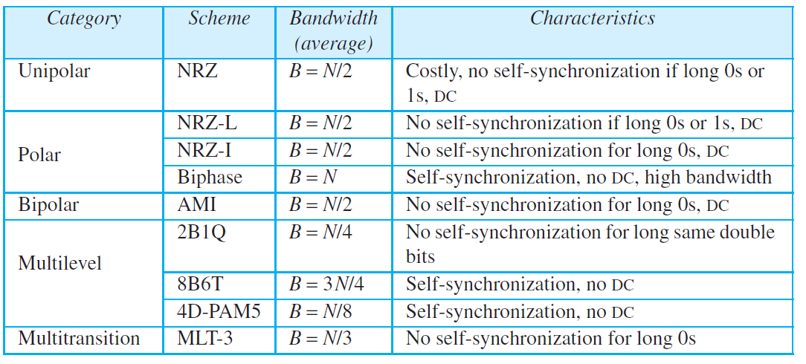
Table 4.1: Summary of line coding schemes
4.25
Notes:
25

Slide 26
4.4.3 Block Coding
We need redundancy to ensure synchronization and to provide some kind of inherent error detecting. Block coding can give us this redundancy and improve the performance of line coding. In general, block coding changes a block of m bits into a block of n bits, where n is larger than m. Block coding is referred to as an mB/nB encoding technique.
Notes:
4.#

Slide 27
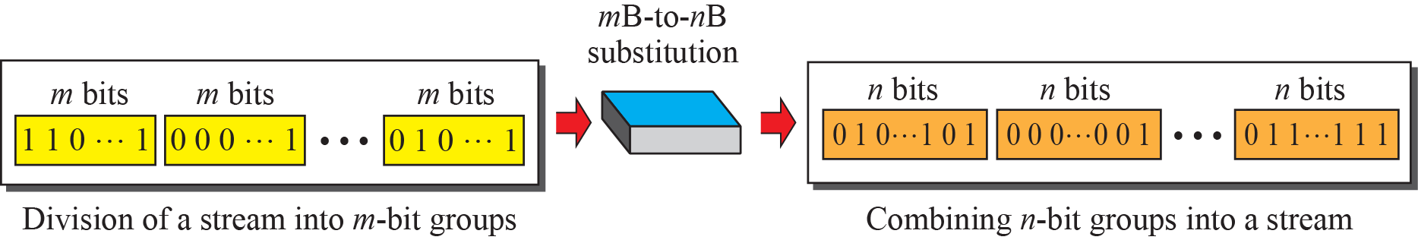
Figure 4.14: Block coding concept
Notes:
4.#

Slide 28
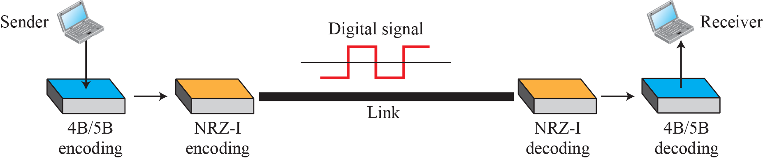
Figure 4.15: Using block coding 4B/5B with NRZ-I line coding scheme
Notes:
4.#

Slide 29
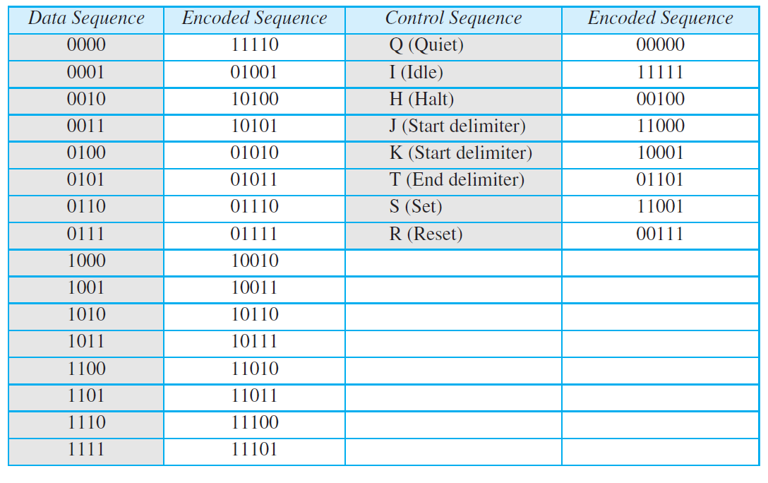
Table 4.2: 4B/5B mapping codes
4.29
Notes:
29

Slide 30
Example 4.5
We need to send data at a 1-Mbps rate. What is the minimum required bandwidth, using a combination of 4B/5B and NRZ-I or Manchester coding?
Solution
First 4B/5B block coding increases the bit rate to 4.25 Mbps. The minimum bandwidth using NRZ-I is N/2 or 625 kHz. The Manchester scheme needs a minimum bandwidth of 1 MHz. The first choice needs a lower bandwidth, but has a DC component problem; the second choice needs a higher bandwidth, but does not have a DC component problem.
Problem here
4B ->5B->5/4=1.25
In NRZ-I N/2=1.25/2=6.25HZ
4.30
Notes:
30

Slide 31
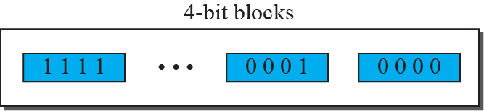



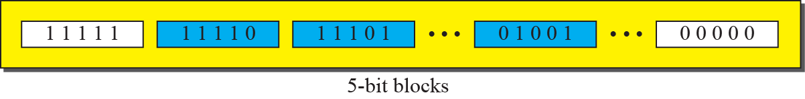
Figure 4.16: Substitution in 4B/5B block coding
Notes:
4.#

Slide 32
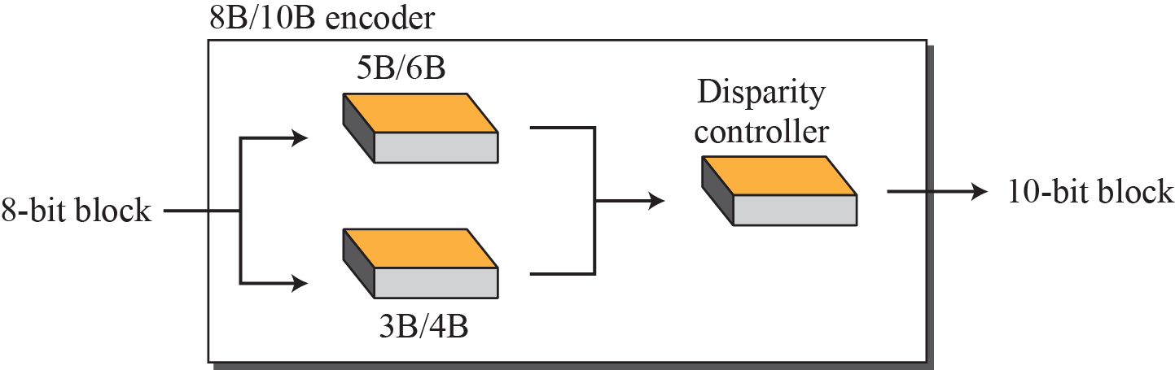
Figure 4.17: 8B/10B block encoding
Notes:
4.#

Slide 33
4.4.4 Scrambling
We modify line and block coding to include scrambling, as shown in Figure 4.18. Note that scrambling, as opposed to block coding, is done at the same time as encoding. The system needs to insert the required pulses based on the defined scrambling rules. Two common scrambling techniques are B8ZS and HDB3.
Notes:
4.#

Slide 34
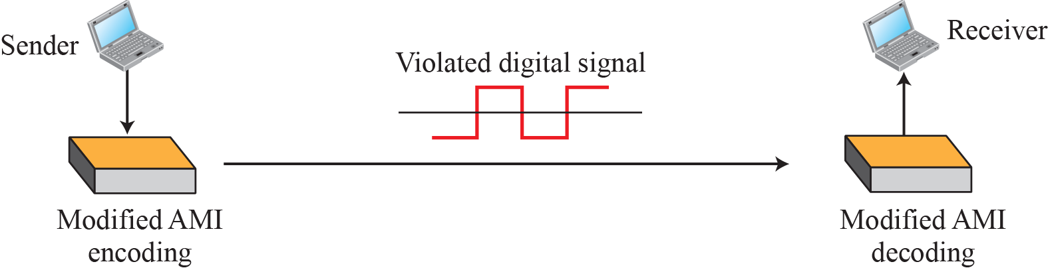
Figure 4.18: AMI used with scrambling
Notes:
4.#

Slide 35
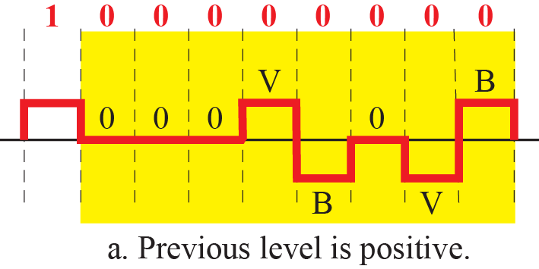
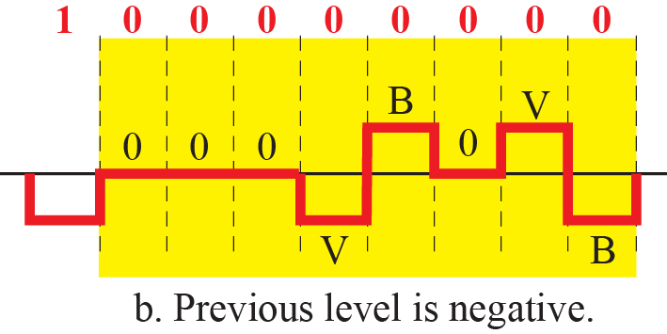
Figure 4.19: Two cases of B8ZS scrambling technique
Notes:
4.#

Slide 36
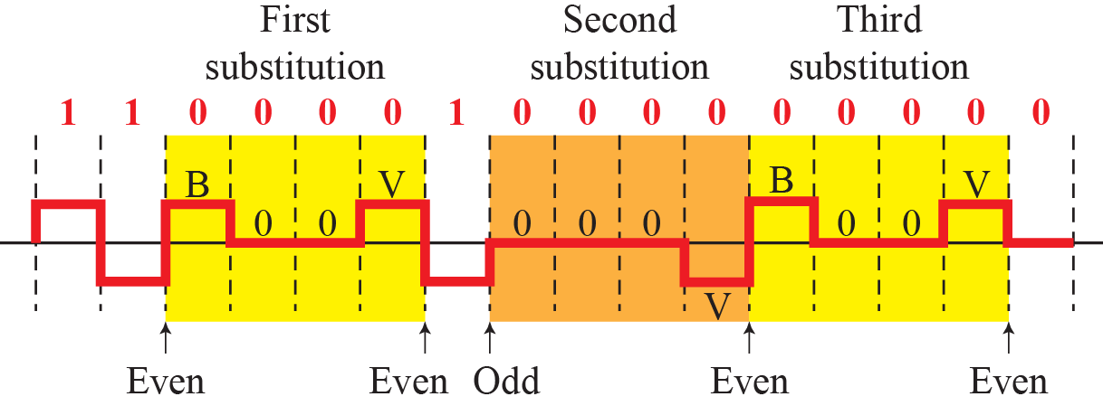
Figure 4.20: Different situations in HDB3 scrambling technique
Notes:
4.#

Slide 37
4-2 ANALOG-TO-DIGITAL CONVERSION
The techniques described in Section 4.1 convert digital data to digital signals. Sometimes, however, we have an analog signal such as one created by a microphone or camera. We have seen in Chapter 3 that a digital signal is superior to an analog signal. The tendency today is to change an analog signal to digital data. In this section we describe two techniques, pulse code modulation and delta modulation.
Notes:
4.#

Slide 38
4.2.1 Pulse Code Modulation (PCM)
The most common technique to change an analog signal to digital data (digitization) is called pulse code modulation (PCM). A PCM encoder has three processes, as shown in Figure 4.24.
Notes:
4.#

Slide 39
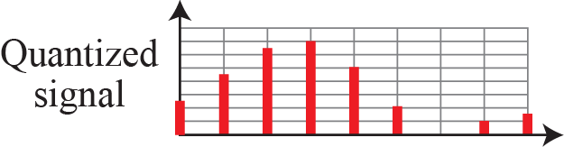
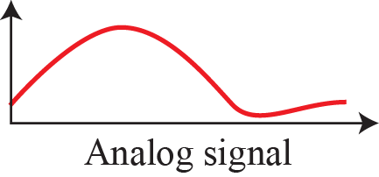
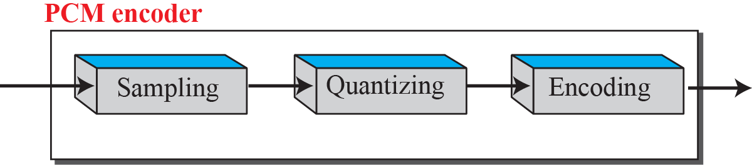
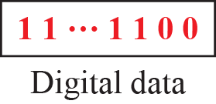
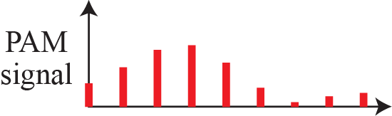
Figure 4.21: Components of PCM encoder
Notes:
4.#

Slide 40
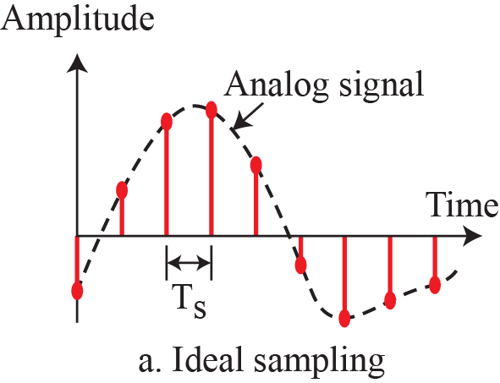
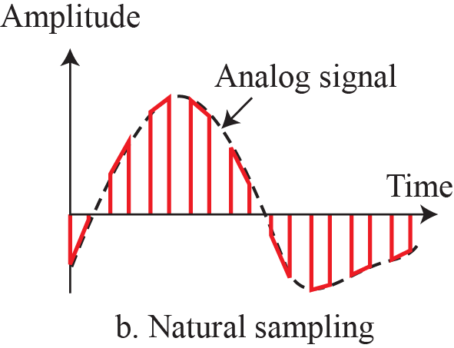
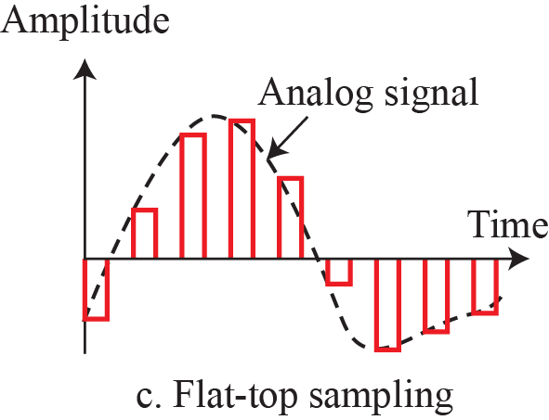
Figure 4.22: Three different sampling methods for PCM
Notes:
4.#

Slide 41
Example 4.6
For an intuitive example of the Nyquist theorem, let us sample a simple sine wave at three sampling rates: f_{s} = 4f (2 times the Nyquist rate), f_{s} = 2f (Nyquist rate), and f_{s} = f (one-half the Nyquist rate). Figure 4.24 shows the sampling and the subsequent recovery of the signal. It can be seen that sampling at the Nyquist rate can create a good approximation of the original sine wave (part a). Oversampling in part b can also create the same approximation, but it is redundant and unnecessary. Sampling below the Nyquist rate (part c) does not produce a signal that looks like the original sine wave.
4.41
Notes:
41

Slide 42
Example 4.7
The frequency domain is more compact and useful when we are dealing with more than one sine wave. For example, Figure 3.9 shows three sine waves, each with different amplitude and frequency. All can be represented by three spikes in the frequency domain.
4.42
Notes:
42

Slide 43
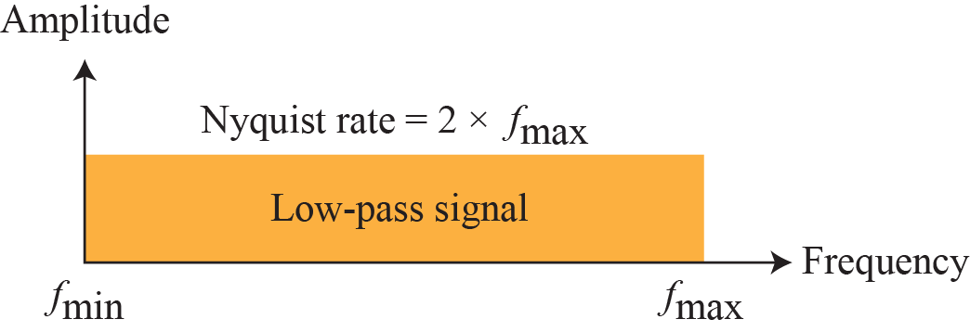
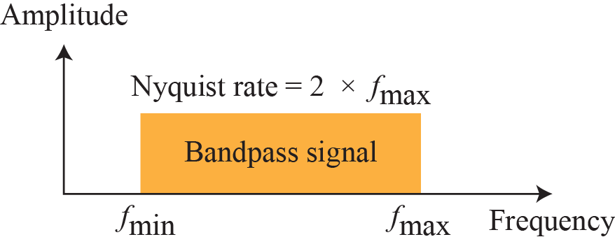
Figure 4.23: Nyquist sampling rate for low-pass and bandpass signals
Notes:
4.#

Slide 44
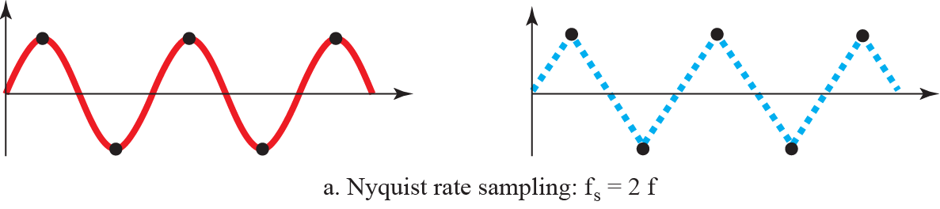


Figure 4.24: Recovery of a sine wave with different sampling rates.
Notes:
4.#

Slide 45



Figure 4.25: Sampling of clock with only one hand.
Notes:
4.#

Slide 46
Example 4.8
An example related to Example 4.7 is the seemingly backward rotation of the wheels of a forward-moving car in a movie. This can be explained by undersampling. A movie is filmed at 24 frames per second. If a wheel is rotating more than 12 times per second, the undersampling creates the impression of a backward rotation.
4.46
Notes:
46

Slide 47
Example 4.9
Telephone companies digitize voice by assuming a maximum frequency of 4000 Hz. The sampling rate therefore is 8000 samples per second.
4.47
Notes:
47

Slide 48
Example 4.10
A complex low-pass signal has a bandwidth of 200 kHz. What is the minimum sampling rate for this signal?
Solution
The bandwidth of a low-pass signal is between 0 and f, where f is the maximum frequency in the signal. Therefore, we can sample this signal at 2 times the highest frequency (200 kHz). The sampling rate is therefore 400,000 samples per second.
4.48
Notes:
48

Slide 49
Example 4.11
A complex bandpass signal has a bandwidth of 200 kHz. What is the minimum sampling rate for this signal?
Solution
We cannot find the minimum sampling rate in this case because we do not know where the bandwidth starts or ends. We do not know the maximum frequency in the signal.
4.49
Notes:
49

Slide 50

Figure 4.26: Quantization and encoding of a sampled signal
Notes:
4.#

Slide 51
Example 4.12
What is the SNR_{dB} in the example of Figure 4.26?
Solution
We can use the formula to find the quantization. We have eight levels and 3 bits per sample, so SNR_{dB} = 6.02(3) + 1.76 = 19.82 dB. Increasing the number of levels increases the SNR.
4.51
Notes:
51

Slide 52

Example 4.13
A telephone subscriber line must have an SNR_{dB} above 40. What is the minimum number of bits per sample?
Solution
We can calculate the number of bits as
Telephone companies usually assign 7 or 8 bits per sample.
4.52
Notes:
52

Slide 53

Example 4.14
We want to digitize the human voice. What is the bit rate, assuming 8 bits per sample?
Solution
The human voice normally contains frequencies from 0 to 4000 Hz. So the sampling rate and bit rate are calculated as follows:
4.53
Notes:
53

Slide 54




Figure 4.27: Components of a PCM decoder
Notes:
4.#

Slide 55
Example 4.15
We have a low-pass analog signal of 4 kHz. If we send the analog signal, we need a channel with a minimum bandwidth of 4 kHz. If we digitize the signal and send 8 bits per sample, we need a channel with a minimum bandwidth of 8 × 4 kHz = 32 kHz.
4.55
Notes:
55

Slide 56
4.2.2 Delta Modulation (DM)
PCM is a very complex technique. Other techniques have been developed to reduce the complexity of PCM. The simplest is delta modulation. PCM finds the value of the signal amplitude for each sample; DM finds the change from the previous sample. Figure 4.28 shows the process. Note that there are no code words here; bits are sent one after another.
Notes:
4.#

Slide 57

Figure 4.28: The process of delta modulation
Notes:
4.#

Slide 58

Figure 4.29: Delta modulation components
Notes:
4.#

Slide 59

Figure 4.30: Delta demodulation components
Notes:
4.#

Slide 60
4-3 TRANSMISSION MODES
Of primary concern when we are considering the transmission of data from one device to another is the wiring, and of primary concern when we are considering the wiring is the data stream. Do we send 1 bit at a time; or do we group bits into larger groups and, if so, how? The transmission of binary data across a link can be accomplished in either parallel or serial mode. and isochronous (see Figure 4.31).
Notes:
4.#

Slide 61

Figure 4.31: Data transmission modes
Notes:
4.#

Slide 62
4.3.1 Parallel Transmission
Notes:
4.#

Slide 63



Figure 4.32: Parallel transmission
Notes:
4.#

Slide 64
4.3.2 Serial Transmission
In serial transmission one bit follows another, so we need only one communication channel rather than n to transmit data between two communicating devices (see Figure 4.33)..
Notes:
4.#

Slide 65



Figure 4.33: Serial transmission
Notes:
4.#

Slide 66




Figure 4.34: Asynchronous transmission
Notes:
4.#

Slide 67



Figure 4.35: Synchronous transmission
Notes:
4.#

